Slide 1
Assessment of Student Learning
PUEBLO COMMUNITY COLLEGE
What It Is, Why It Matters, and How We Do It
Notes:
Open with the headline: Fall data is fully loaded and the faculty flow works end to end on test data. Then walk the screens, then the asks.

Slide 2
What is Assessment?
"Are our students learning the essential skills and knowledge that we value as educators, and how can we help them learn even better?"
Student-Centered
Focuses entirely on student learning and achievement (not teacher evaluation or performance).
Faculty-Driven
Guided by what subject-matter experts value and want students to achieve.
Improvement-Oriented
Focused on finding practical ways to strengthen teaching, assignments, and curriculum.
THE GOOD NEWS:
This is something we already do all the time!
EVEN BETTER:
shared methods = more consistency + less busywork + broader view of student learning

Slide 3
Expectations & Timeline
The Core Expectation:
Who: All instructors (anyone with a teaching assignment) | When: Each semester you teach (including summer) Minimum: Assess at least one class per semester
3 Simple Steps:
1. Select an Activity
Pick an existing assignment (no need to invent a new one!)
2. Apply a Rubric
Use an institutional rubric (4-point scale: Beginning to Exemplary) or department rubric
3. Enter Scores
Input rubric scores into Panther Tracks before the end-of-term grading deadline

Slide 4
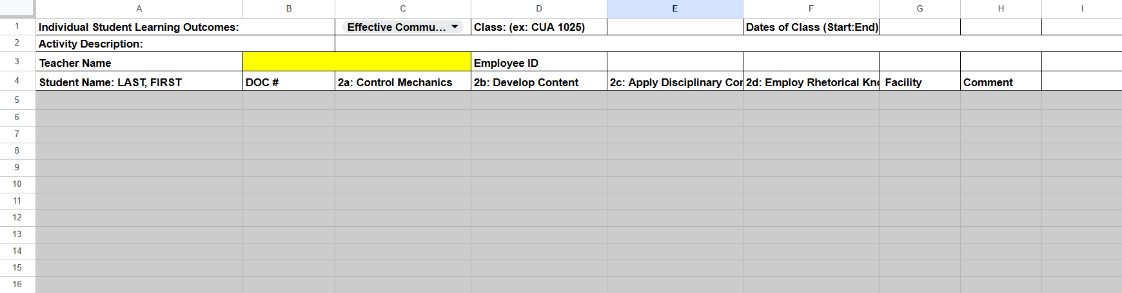
THE OLD WAY FOR DOC PARTNERS
Shared Google spreadsheet will be retired
Avoid messy/inconsistent data entry
Minimize need to clarify/correct
For the time being: feel free to still use it to track your students’ scores!

Slide 5
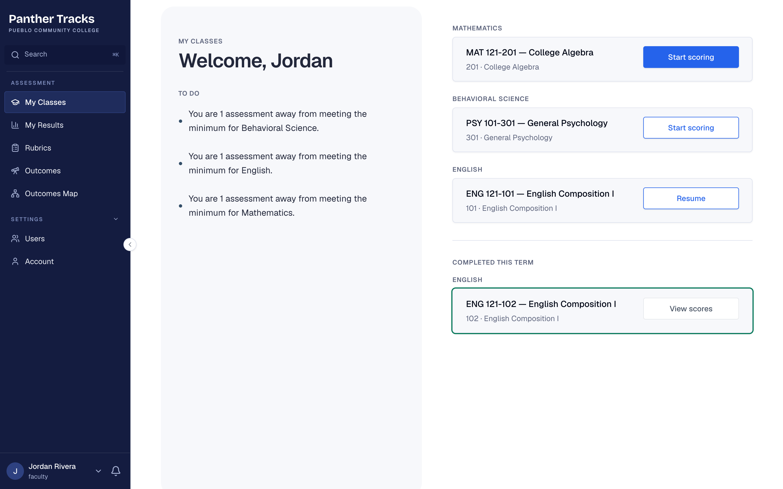
My Classes is your to-do list
THE NEW WAY FOR EVERYONE
FOR FACULTY
Every class you teach, grouped by department, with one button to start or pick up scoring. The left side says how many assessments each department still needs.
Panther Tracks · Pueblo Community College · All screens use made-up names and data
Notes:
This is the first thing an instructor sees after opening Panther Tracks from D2L.

Slide 6
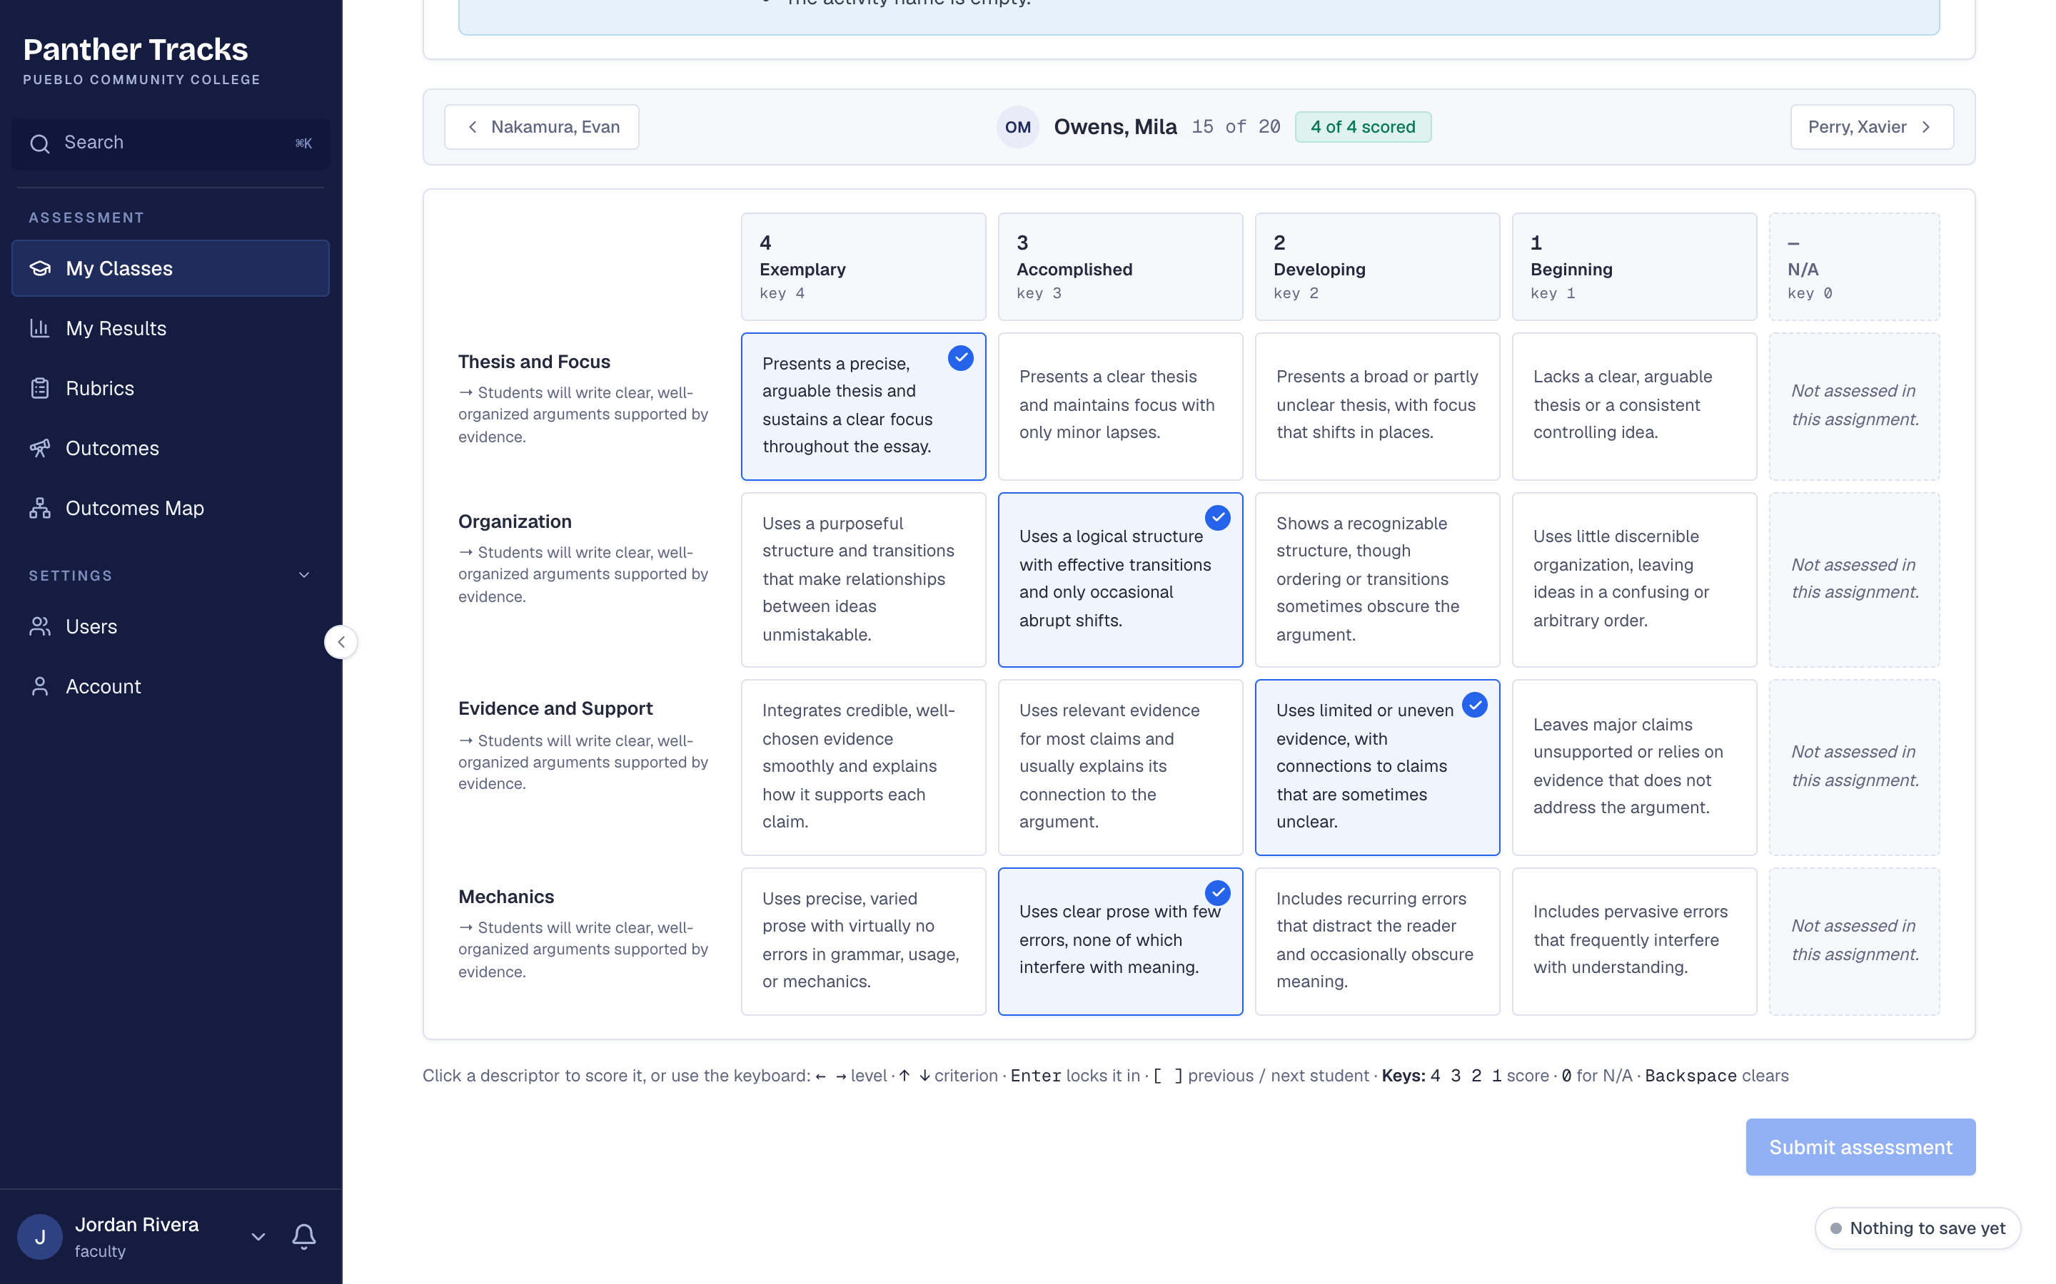
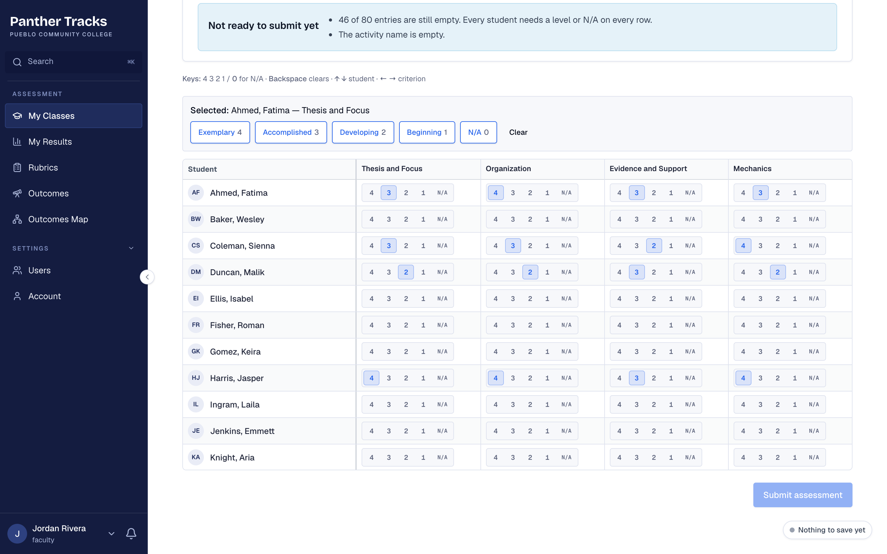
Score one student at a time, or the whole class at once
SCORING
One student at a time, with the full rubric descriptions on screen
The whole class in one grid, with keyboard shortcuts
Panther Tracks · Pueblo Community College · All screens use made-up names and data
Notes:
Scores save on your own. Instructors can switch views any time.

Slide 7
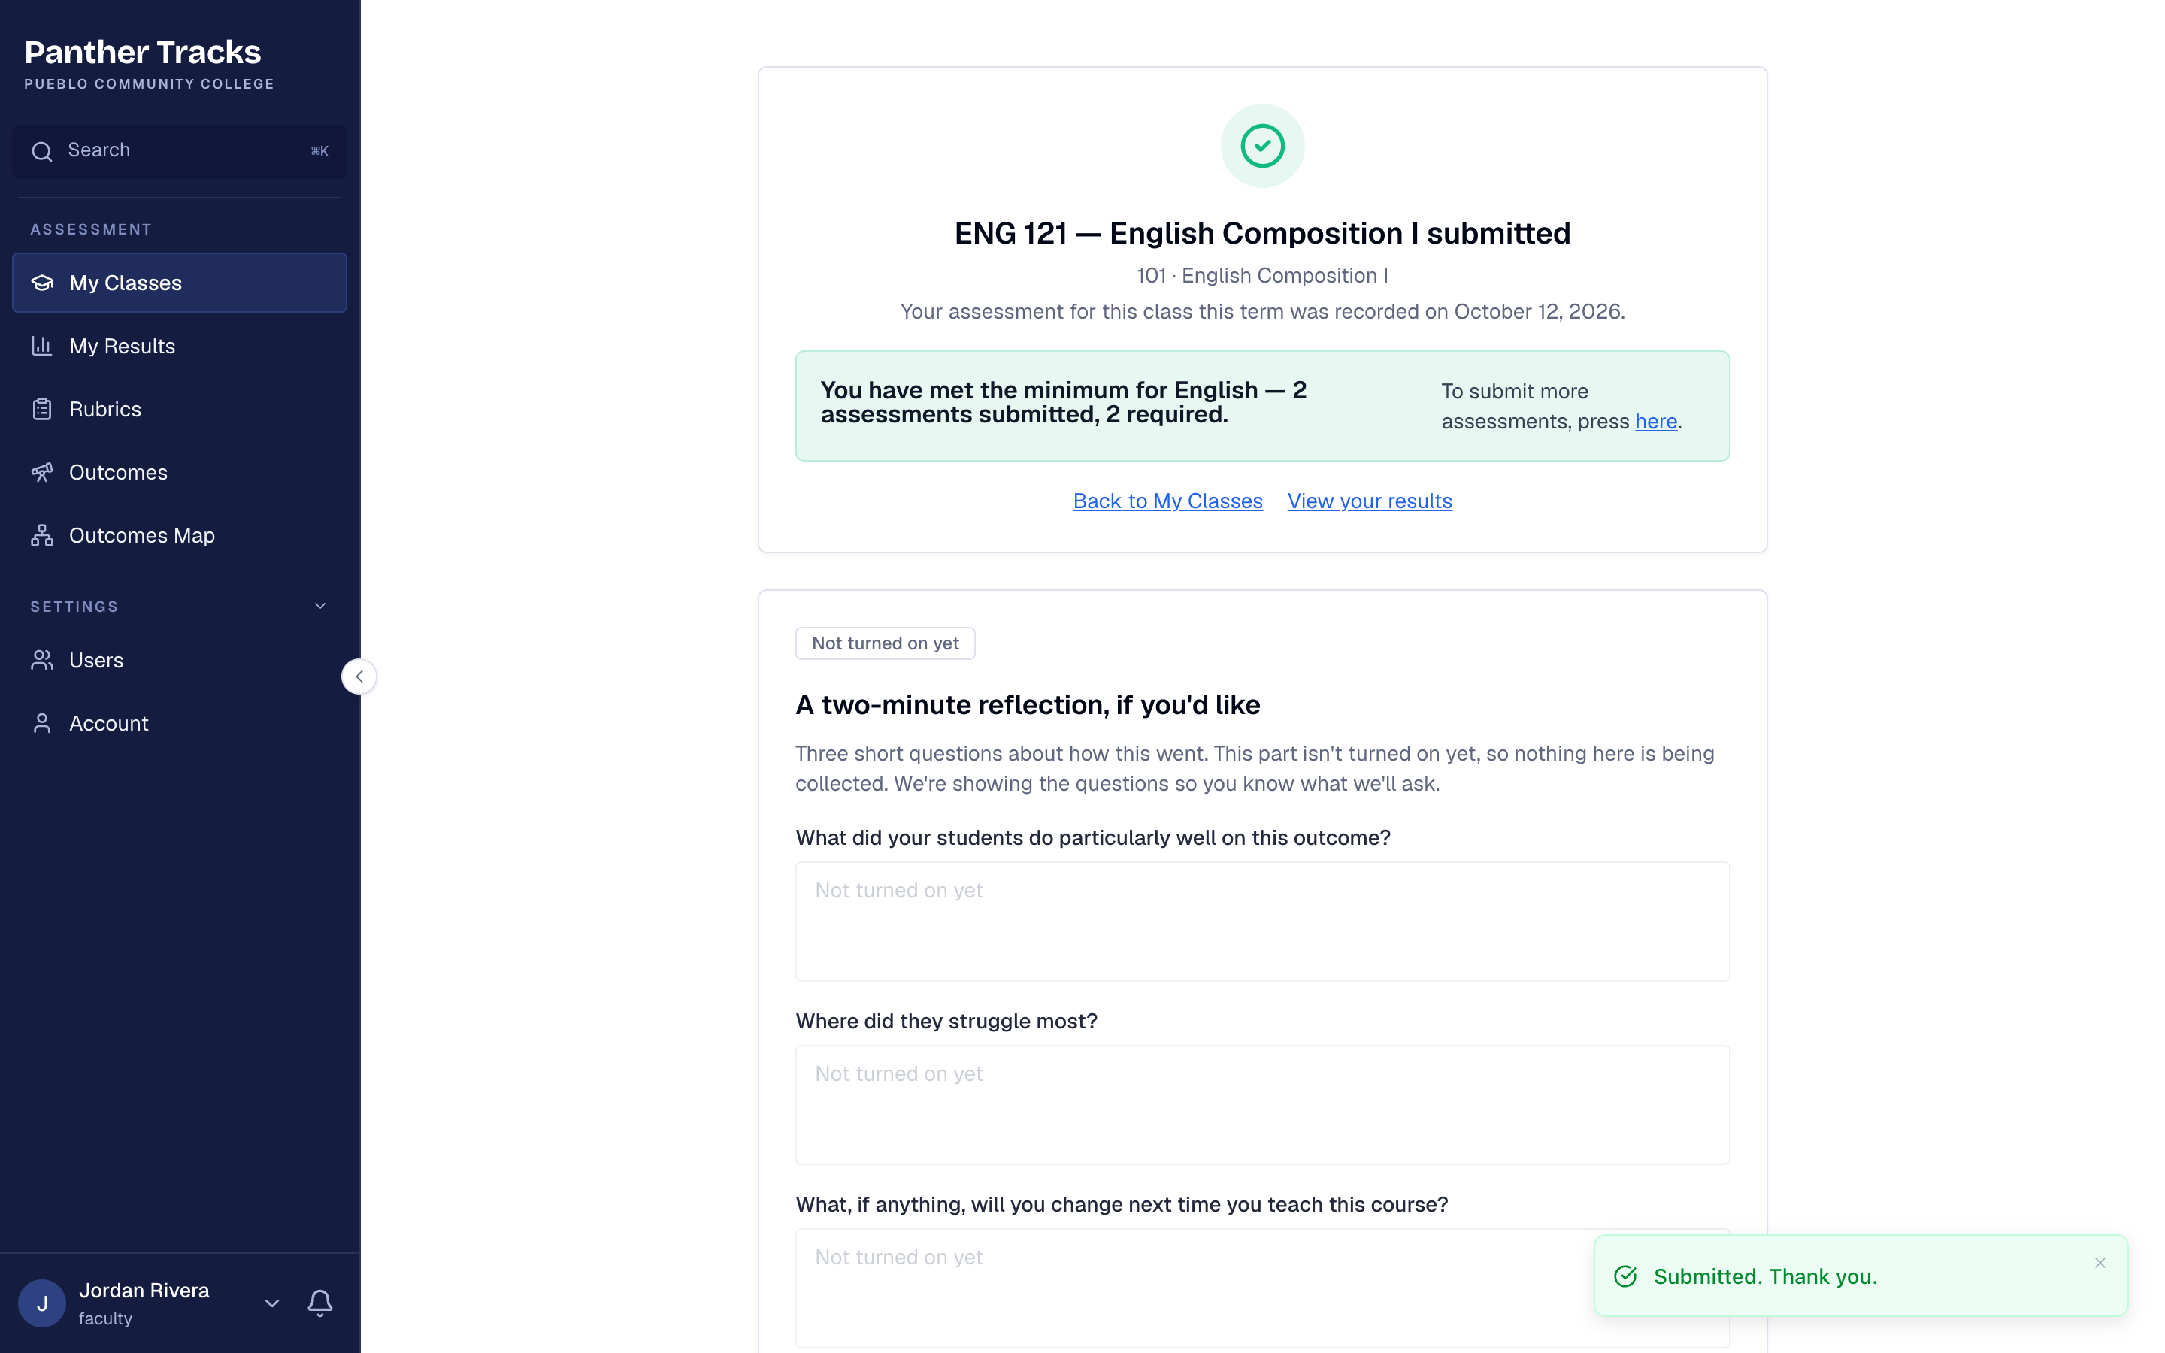
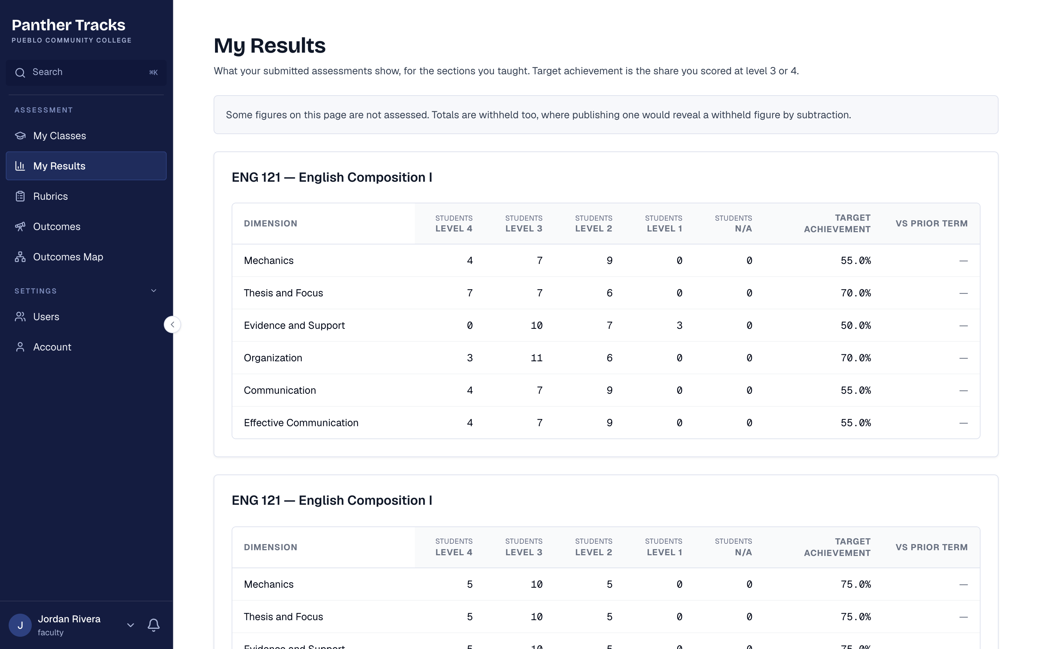
Submitting is one click, and results come straight back
SUBMIT AND RESULTS
After submitting: confirmation and where you stand against the department minimum
My Results: how your students did, by outcome
Panther Tracks · Pueblo Community College · All screens use made-up names and data
Notes:
Reflection questions after submitting now save, and stay private to the instructor.

Slide 8
QUESTIONS?
Go to PCCassess.com for guides, glossary, rubrics, examples, results, and much more!
Quick Reference Guide to Assessment Support: PCCassess.com/resources
Assessment Support Team Contact Information: PCCassess.com/contact
Liz Medendorp, Director of Assessment of Student Learning: liz.medendorp@pueblocc.edu

