Slide 1
Assessment Updates – 10/23/23
Assessment Showcase – Poster Submissions
Expectations Survey
CoRAC Conference – 2/16, Northeastern Junior College
Arts & Sciences – Committee Representative Needed
Student Services Assessment
eLumen Walkthrough

Slide 2
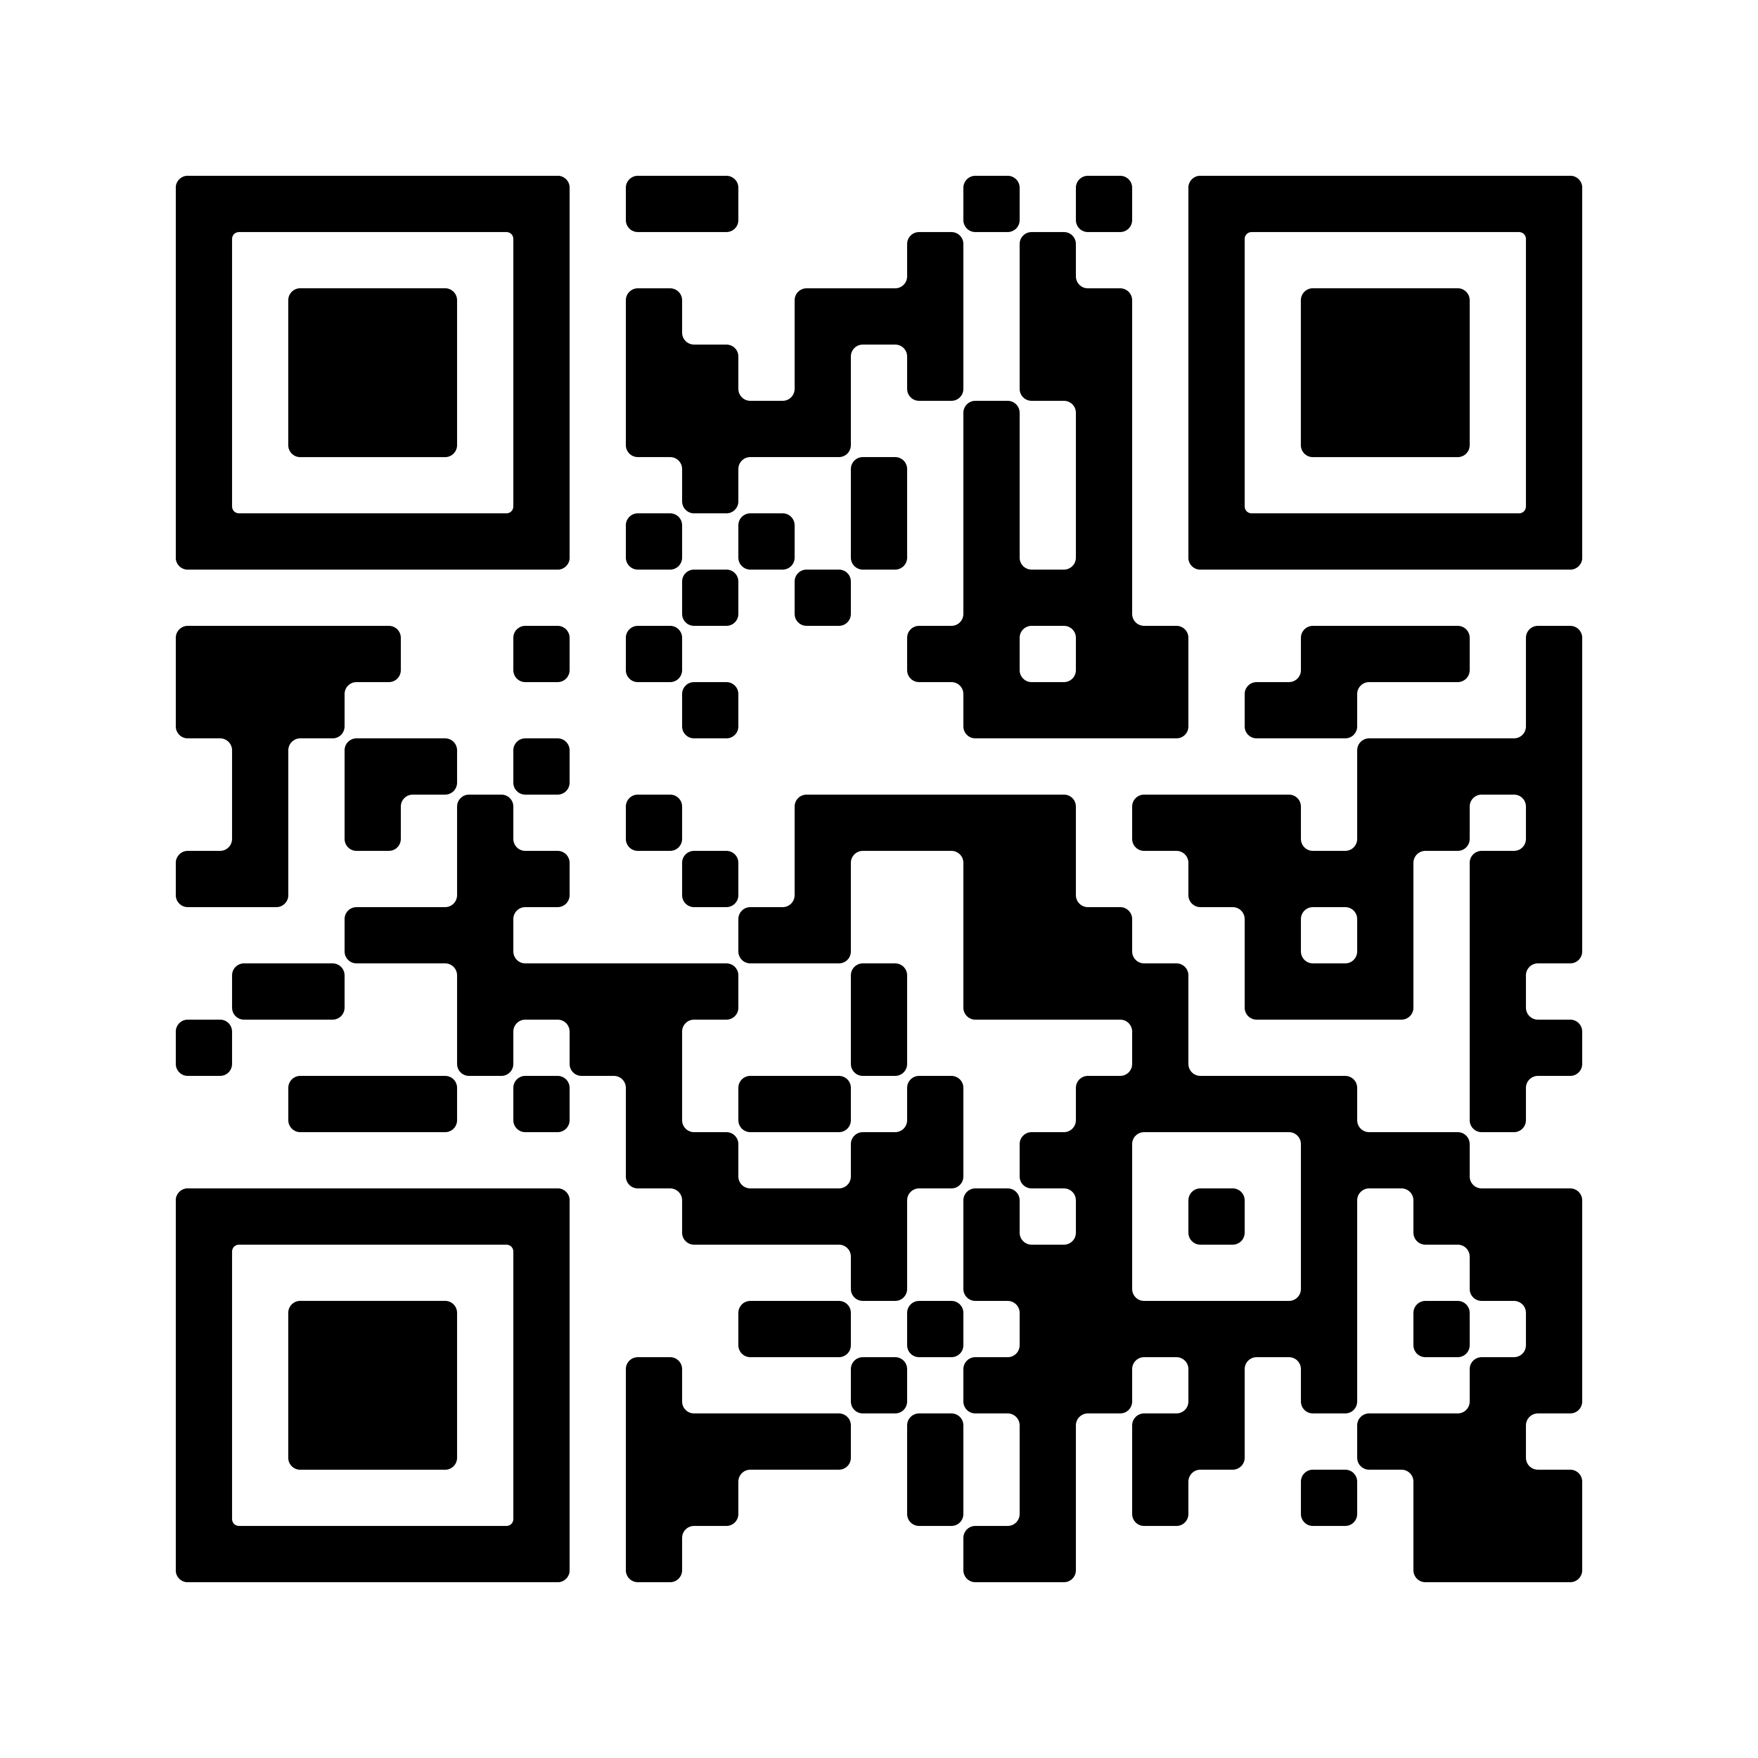
Assessment Showcase
Scan the QR Code to access the submission form, or go to:
bit.ly/PCCshowcase

Slide 3
Opportunities for Involvement
Expectations Survey
Friday, February 16 (9:15AM-3:15PM)
Northeastern Junior College (Sterling, CO)
Registration is FREE!
Presentation Proposals (due 11/15)
Full details at: PCCassess.com/2024-corac-conference
Assessment Committee Representative Needed
Student Services Assessment
2024 Colorado Regional Assessment Council Conference
Part 1: What does it mean to participate in assessment at PCC?
Survey Link: bit.ly/PCC-ASLsurvey
Respond by Friday 11/17
Arts & Sciences Division: Full-Time Faculty, Part-Time Instructors, or APT with teaching assignment are all eligible to serve
Contact Liz Medendorp or Amanda Mayes if interested!
Library, Financial Aid, TRIO
More in the works!

Slide 4
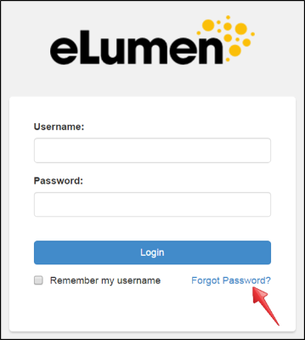
eLumen Walkthrough: Logging in
PCC Portal: Faculty & Instructor Tab
Assessment Blog Quick Links: PCCassess.com
First-Time Login: Set your password using the "Forgot Password" link
  Username: your S number
  Associated email: @pueblocc.edu account
  Password: requires at least 1 special character

Slide 5
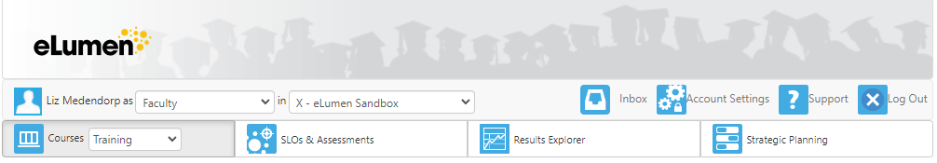
Navigation
Top Menu:
Name
Role (Faculty)
Program
Navigation Tabs:
"Courses" is home base!
  Tip: click on the icon itself, not the drop-down
Make sure you have the correct term selected

Slide 6
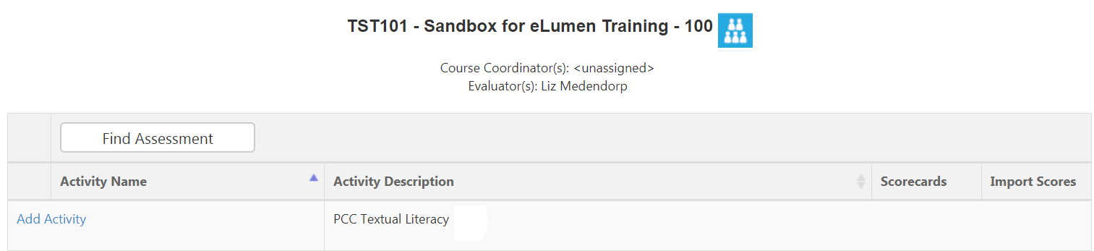
Courses – Find Assessment/Add Activity

Slide 7
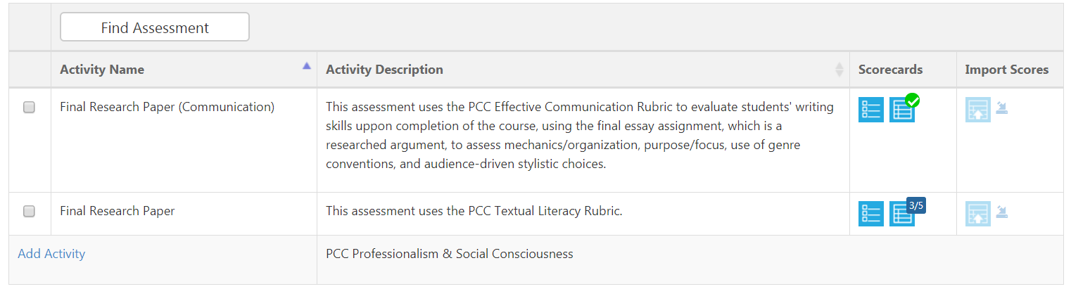
Open Scorecards – 2 Views

Slide 8
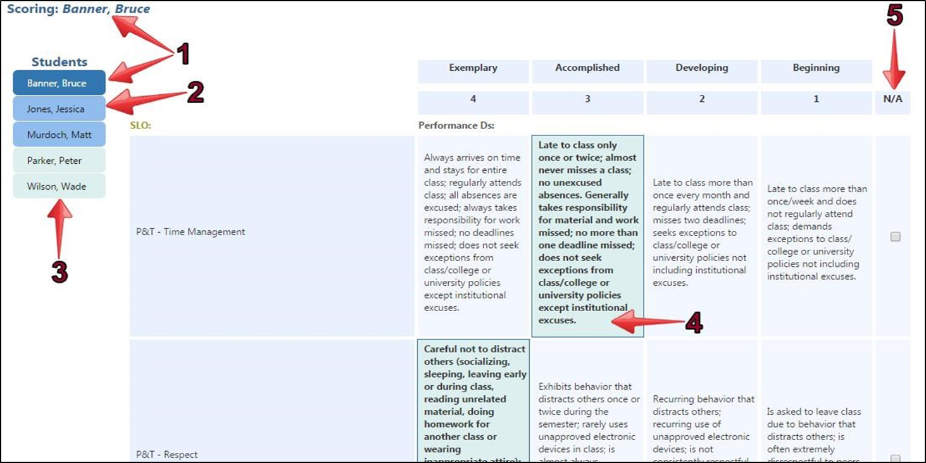
Rubric View

Slide 9
Assessment Updates 10/23
Assessment Showcase (poster submissions due 12/1): bit.ly/PCCshowcase
Expectations Survey (please respond by 11/17): bit.ly/PCC-ASLsurvey
CoRAC Conference Registration (free!) and Presentation Proposals (due 11/15): PCCassess.com/2024-corac-conference
Assessment @PCC Blog: PCCassess.com
Important Links
Reminder:
A&S Committee Representative Needed! Contact Liz Medendorp or Amanda Mayes if interested :)

